Slide 1


PREPLACEMENT PROJECT
DIVYANSH KUMAR GUPTA
MENTOR: SHRUTI GODE

Slide 2
BUSINESS OBJECTIVES
DESCRIPTION: The dataset has information about the TV and Movies available on Netflix from the year 2008 to 2021. Netflix is an application that keeps growing exponentially whole around the world and it is the most popular streaming platform.
Identify the most popular entertainment genres and regions, with a focus on expanding market presence. By analyzing user preferences and consumption patterns, we aim to pinpoint regions that contribute significantly to the entertainment industry.

Slide 3


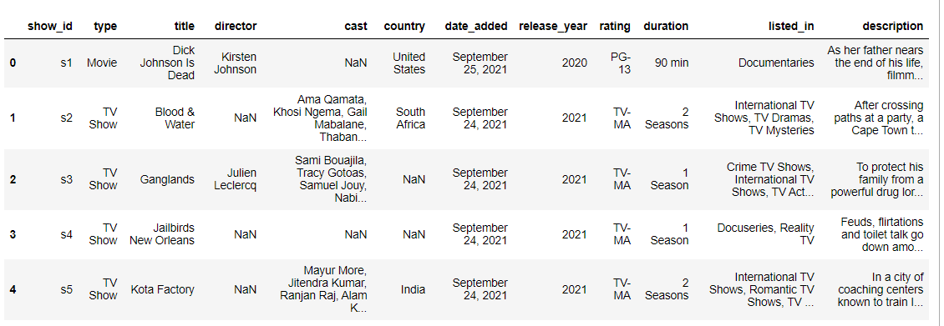
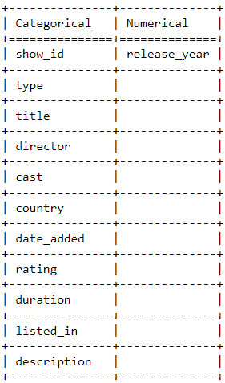
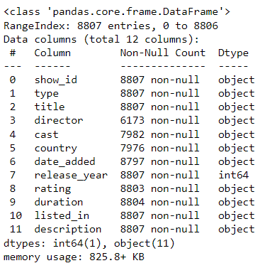
DATA UNDERSTANDING
Note: Among the 12 columns 11 columns are categorical and only 1 column is numerical so outlier treatment is prevented in the analysis.
DATASET

Slide 4
DATA CLEANING
Data preprocessing is a crucial step in the data analysis. It involves cleaning, transforming, and organizing raw data into a format that is suitable for analysis.
In this Netflix dataset there are null values present in some categorical columns like ‘director’ - 2634, ‘cast’ - 825, ‘date_added’ - 10, ‘rating’- 4 and ‘duration’- 3.
In order to clean the data, a function is defined in python that replaces the null values with mode and prints the number of unique values, the mode and the null values present in the column. To clean the data the function needs to be called everytime.
After the data cleaning process the dataset is been exported in csv format and is now ready to be analysed further using ‘Tableau’.

Slide 5
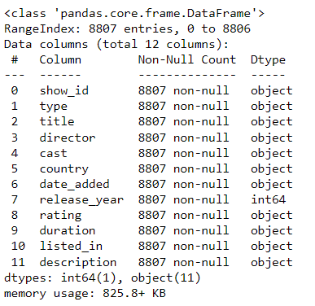
DATA CLEANING
BEFORE NULL-VALUE TREATMENT
AFTER NULL-VALUE TREATMENT

Slide 6

DATA VISUALIZATION

Slide 7
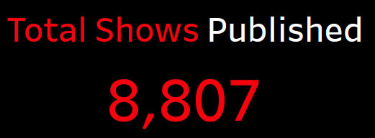
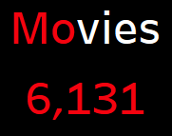
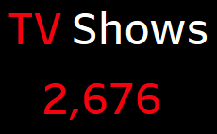

Slide 8
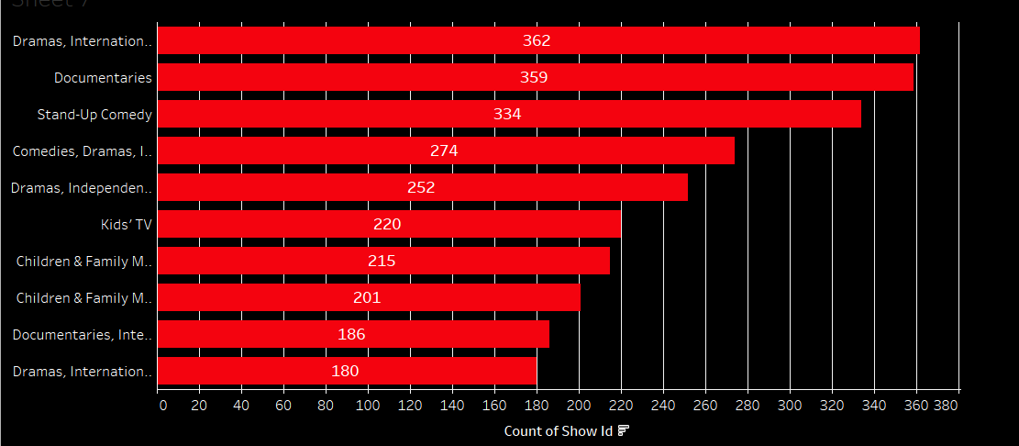
TOP 10 GENRE WISE COUNT OF SHOWS LISTED
Interpretation: The visual shows that Dramas, International Movies, Documentaries, Stand-up-comedy are the top listed genres with highest count of shows.

Slide 9
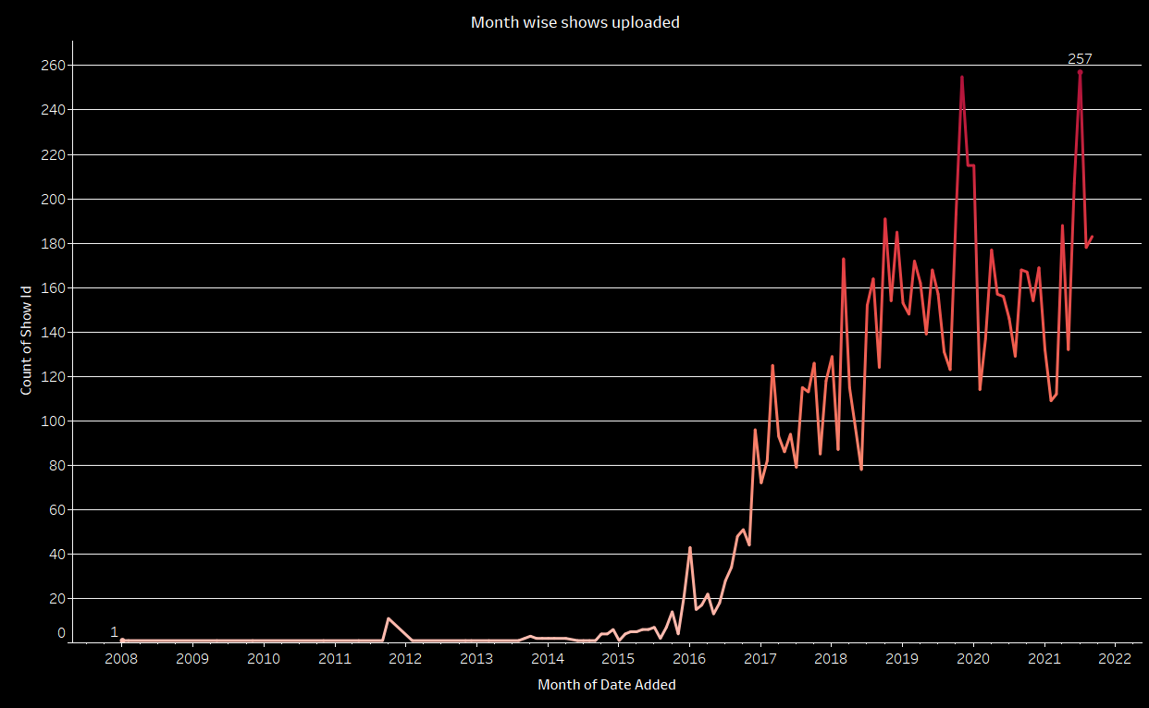
YEAR WISE SHOWS PUBLISHED
Interpretation: The visual shows that between the period September 2019 to July 2021 there has been a tremendous hike in publishing the shows

Slide 10
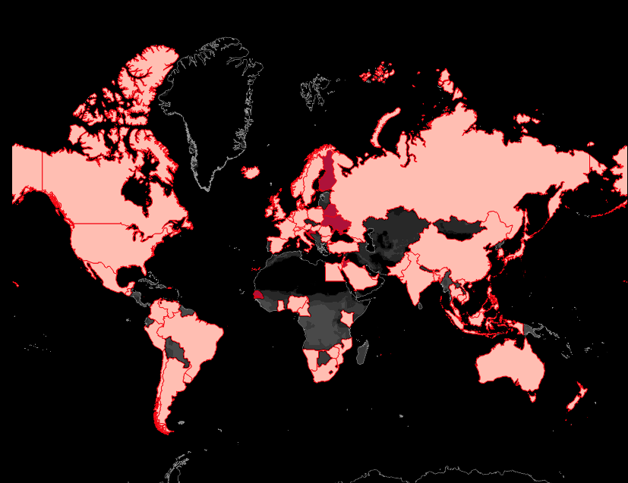

COUNTRY WISE SHOW TYPE
Interpretation: The visual shows that most of the countries are having show type as movies and rest are tv shows. Based on the highest count of shows, countries like US, India, UK, Canada and Spain has ranked top 5 and Russia at 162nd rank.

Slide 11
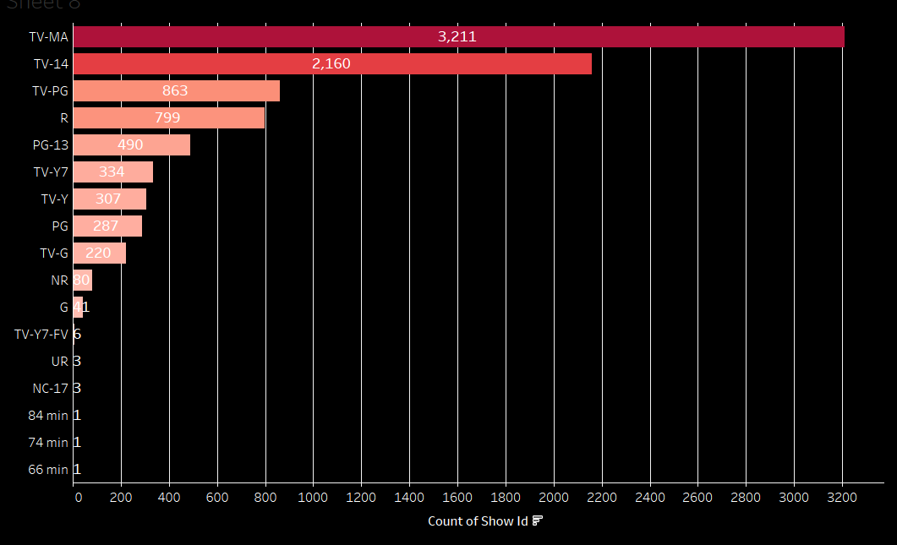

RATING WISE COUNT OF SHOWS
Interpretation: The visual shows that most of the shows published on the platform are TV-MA rated i.e, 3,211 which is not suitable for family to watch and only 41 shows are general rated

Slide 12
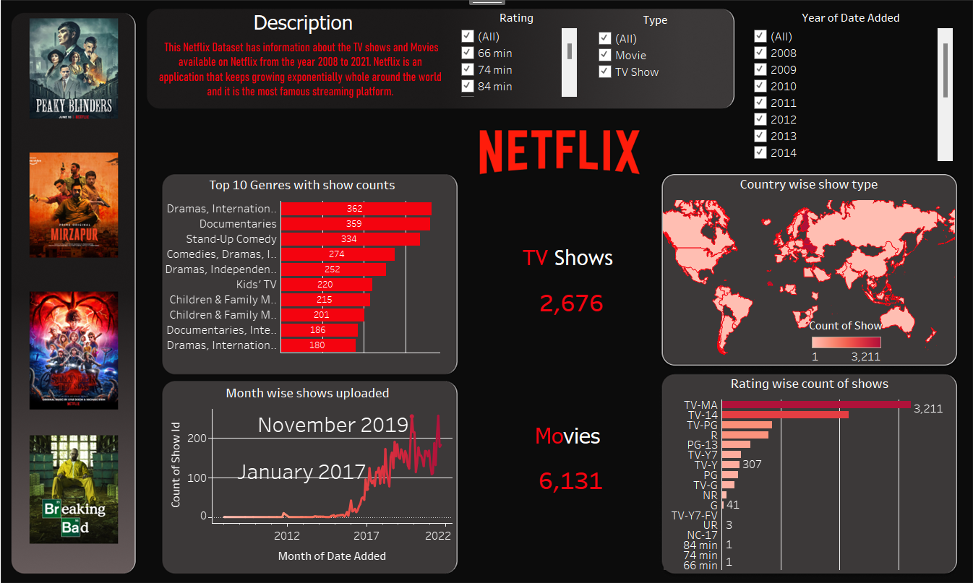

Slide 13
CONCLUSION
Based on our analysis aligned with the business objective, drama, documentaries, and stand-up comedy are identified as the most popular and growing genres. The platform is experiencing an uptick in adult content (TV MA, TV 14, TV P, R), suggesting a market trend to capitalize on.
Geographically, the top entertainment content publishers are the US, India, UK, Canada, and Spain, while Russia ranks least. These insights guide our strategy, allowing us to focus content creation and expansion efforts in high-performing genres and regions for maximum impact in the global entertainment market.

Slide 14
THANKYOU

